Slide 1
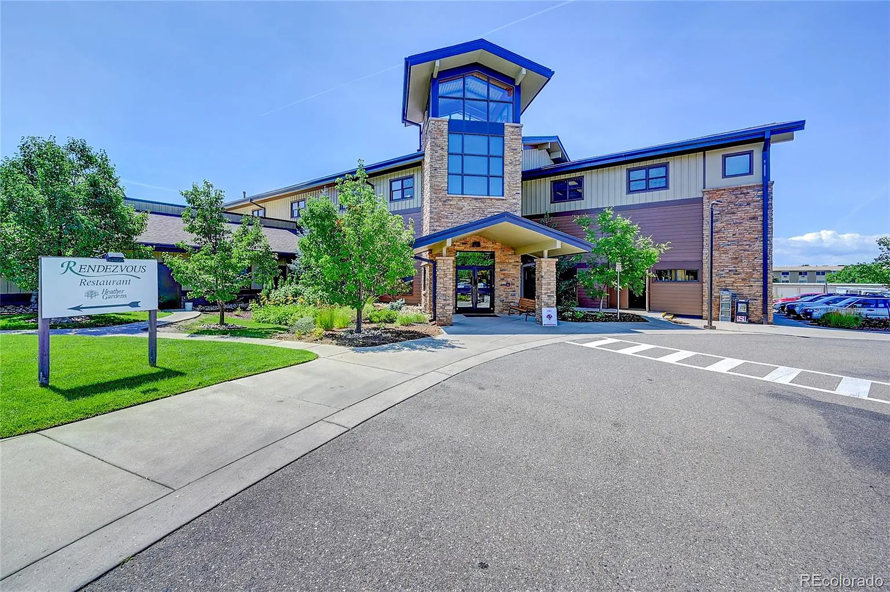
How HGMD Works

Slide 3
Agendas are the public notice for a meeting and what will be discussed. Usually, there are board or committee packets which are posted with the agenda containing information which will be discussed at the meeting. Motions are the request for action at a public meeting. The motion will be approved or denied based upon majority vote. Both organizations create minutes to document the actions taken during a board meeting. Minutes are usually approved at the following board meeting and are kept as Association or public records.

Slide 4

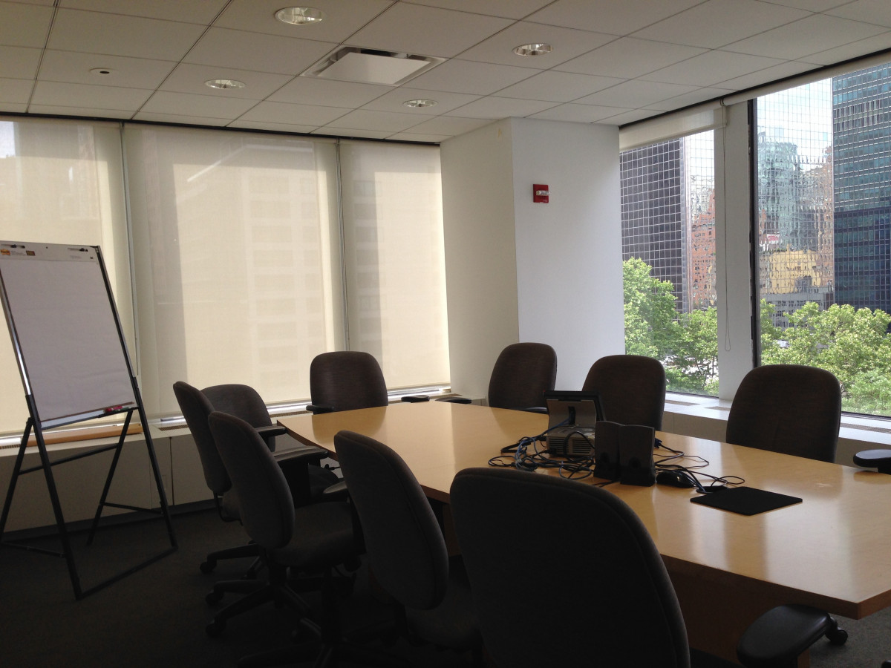

Slide 7
HGA Proposed Lease Option – First Reason
HGMD will not lease the District properties to HGA for two reasons
  HGMD has a right to substantiate the wages HGA charged to HGMD for wages and benefits.
  This is the only insight HG residents will have into employee costs.
  HGA has continually added to the number of employees while contracting out more and more duties.
  HGA has refused to honor HGMD’s oversight and policy rights under the management agreement, resulting in the current litigation.
  HGA’s proposal to lease the District’s property would eliminate HGMD’s oversight and policy rights all together.

Slide 8
HGA Proposed Lease Option – Second Reason
Mismanagement
  Capital expenditure requests have been incompetent and not corrected.
  HGA staff signed a contract for more than twice the highest CEO spending authorization and scheduled another project without contract at all.
  HGA staff has stated something as law which was incorrect.
  HGA staff has been unresponsive to HGMD complaints or requests.
Intentional Misconduct
  At what point after being warned about unlawful conduct, does the refusal to correct a problem become intentional misconduct?

Slide 9
HGA Has Exposed HG to 3-4 Million $ Liability
2 Counts Federal False Claims Act Violations
  HGA has been served with a federal lawsuit for the mishandling of its $1,058,700 PPP loan during 2020.
  The loan was received in April 2020 - deposited into HGA Operating Account.
  The loan would be forgiven if 75% was spent on wages before Oct 3rd, 2020.
December 31, 2020, Balance Sheet
  HGA CASH BANK ACCOUNT (PPP Proceeds) TOTALED $1,058,700.
  HGA could not have spent the loan proceeds on wages when the proceeds are still in the bank.

Slide 10
HGA Has Exposed HG to 3-4 Million $ Liability
July 8, 2021, Forgiveness Application
  HGA President Jill Bacon Applied for the PPP loan forgiveness under the penalty of perjury, that HGA complied with the requirements, that it spent over $2.1 million on wages before October 3rd, 2020.
  The application required that proof of payment must be attached.
CFO Jerry Counts
  CFO Jerry Counts was hired in March 2021.
  There were no balance sheets prepared from January – April 2021.
  In May 2021, the HGA Balance Sheet shows $1,302,772 in the PPP Proceeds bank account.
  Jerry Counts said that HGA provided a copy of the cash disbursement to the PEO to prove payment. But the cash disbursement was from the operating acct, not the PPP proceeds.
  In August 2021, after the loan was forgiven, the balance was $1,058,700.

Slide 11
  At what point after being warned about unlawful conduct, does the refusal to correct a problem become intentional misconduct?
  Sept. 20, 2021, B&F Committee Meeting, committee members requested a formal, written opinion on permissible uses for the loan proceeds. Jerry Counts would talk to the auditors and attorneys.
  April 18, 2022, B&F Committee Meeting, Bill Archambault and Ray Nash questioned whether HGA needed the loan, and whether SBA could audit HGA requiring the return of the proceeds. Candice Compton said for the loan to be forgiven it had to be spent (on wages before 10/3/2020)
  Jerry Counts minimized the risk that SBA would audit HGA.

Slide 12

Page 1, PPP Loan Application
This is the important part.
Heather Gardens Association declared itself
a C-Corp.
It is not a C-Corp. A C-Corp is a for-profit business, like Walmart.
HGA is Not-for-Profit Corp which qualifies as a tax-exempt HOA under IRC Section 528. It files an 1120-H tax return.

Slide 13

2024 BUDGET
HGMD Average Dues
Summary | 2024 | 2023 | Increase
Average Dues | $1,921,019 | $1,739,378 | $181,641
Percent of Increase | 10.44% | 16.21% | -5.77 %
Average Dues Per Month | $65.99 | $59.75 | $6.24
Adopted October 12, 2023
Notes:
On Page 6 of the published HGMD Budget, you’ll find a summary of the total dues, the percentage of increase, and the average dues per month.
We have lowered the increase of dues from 16.21% in 2023, to 10.44% for 2024. (Page 8 2023 Budget). HGA dues increased 10.91%.
This includes fully funding the restaurant as we’ll go over later. The average monthly dues will increase $6.24.

Slide 14
We told Jerry Counts the hours we’d like the restaurant open. He calculated this number.
This is the result of keeping wages secret. We have added two positions in the restaurant & we’re rolling out the changes gradually as we promised.
 | Amount | Percentage of Budget
Total Labor | $1,086,640 | 78%
Utilities | $109,401 | 8%
 |  | 86%
Notes:
Restaurant labor runs at a higher percentage of the total budget. But we honestly don’t know how accurate these numbers are. Jerry used a proportionate share for cost of goods sold, and Cormac gave him the number of additional part-time hours that would be needed for a full schedule. These numbers will likely adjust.
After the budget workshops, I was criticized by a very loud, but fortunately very few. The same few who protested our campaigning and said we couldn’t post flyers, used the Area Representative’s Organization to post flyers accusing me of a “20 minute blistering attack on Jon” Rea at the budget meetings. That didn’t happen, and the person who wrote the email didn’t attend the budget workshops.
What did happen was that the entire HGMD met with Jerry Counts and Jon Rea in August and we agreed to fully fund the restaurant. Later, Jon and Jerry decided to change those numbers and actually reduce the restaurant’s funding in the Sept. 8th Manager’s Budget without notifying us. That was the extend of what happened and what was explained at the budget workshop.
We hope that all of you will support the restaurant, commit to attending at least once a week, and watch for the new events and menu items that will be coming!

Slide 15
2024 Budget
Full Time Employees = 5
Wages & Benefits = $426,573
Allocation from R&G = $53,000
Golf Manager 1
Groundskeepers 2
Equipment Mechanic 1
Total 4

Slide 16
Prepared 9/6/2023
Golf

Slide 17
Golf

Slide 18
9/1/2023 Email from HGA Attorney -
…whether HGMD will agree to pursue the concept of hiring and overseeing the staff that provide direct services…
HGA’s Board of Directors needs to know whether HGMD will work toward separately employing its own personnel before committing to a specific timeline on the management agreement.

Slide 19


This is the problem – Harold Borquez. They don’t want to designate him as FT Golf pending a split of employees.
Golf

Slide 20

2024 Budget
Full Time Employees = 5
Wages & Benefits = $426,573
Allocation from R&G = $53,000
Golf Manager 1
Groundskeepers 2
Equipment Mechanic 1
Total 4
Harold Borquez 1
Total 5
Next Problem:
When asked who the $53,035 charge from R&G was for, Jon Rea said Matt Martella and Harold Borquez’s hours

Slide 21
 | 2024 | 2023 | 2022 | 2021 | 2020 | 2019 | 2018
HGA Wages | $ 5,312,351.00 | $ 5,251,105.00 | $ 4,930,564.00 | $ 4,810,910.00 | $ 4,874,763.00 | $ 4,239,052.00 | $ 3,888,640.00
Clubhouse | $ 390,826.00 | $ 338,062.00 | $ 313,459.00 | $ 279,092.00 | $ 233,133.00
Golf | $ 479,607.00 | $ 513,138.00 | $ 467,362.00 | $ 470,576.00 | $ 488,601.00
Restaurant | $ 1,157,750.00 | $ 421,174.00 | $ 382,602.00 | $ 300,890.00 | $ 279,063.00
HGMD Total | $ 2,028,183.00 | $ 1,272,374.00 | $ 1,163,423.00 | $ 1,050,558.00 | $ 1,000,797.00
Combined Total | $ 7,340,534.00 | $ 6,523,479.00 | $ 6,093,987.00 | $ 5,861,468.00 | $ 5,875,560.00
HGMD Percentage | 28% | 20% | 19% | 18% | 17%
Headcount
Custodial | 10 | 9 | 9 | 10 | 10 | 8 | 7
Contracts | 3 | 3 | 2 | 2 | 2 | 2 | 2
Maintenance | 24 | 24 | 24 | 24 | 24 | 24 | 22
Admin | 11 | 11 | 9.5 | 11 | 9 | 9 | 8
Paint | 5 | 5 | 5 | 5 | 6 | 6 | 6
Roads & Grounds | 17 | 15 | 15 | 14 | 14 | 11 | 10
Security | 9 | 9 | 8 | 8 | 7 | 8 | 7
HGA Total | 79 | 76 | 72.5 | 74 | 72 | 68 | 62
Clubhouse | 2 | 2 | 2 | 2 | 1 | 2 | 2
Golf Pg 45 | 5 | 5 | 5 | 5 | 5 | 4 | 3
Restaurant | 15 | 5 | 4 | 5 | 2 | 3 | 3
HGMD Total | 22 | 12 | 11 | 12 | 8 | 9 | 8
Combined Total | 101 | 88 | 83.5 | 86 | 80 | 77 | 70
Additional FT | 13 | 4.5 | -2.5 | 6 | 3 | 7
 |  | From 2018 to 2023 + 18 people |  | (4 HGMD)

